Slide 1

Django Deployment
on Linode

Slide 2
Django
Let’s explore how to deploy our Django application to the web so anyone can visit our site!
Let’s think about our key requirements…

Slide 3
Django
Key Requirements:
Anyone can visit our website online.
We don’t want to concern ourselves about uptime or resiliency.
Need to support Python/Django.
Need to connect to cloud server.
Need to be able to push updates to our code and have version control.

Slide 4
Django
Cloud Service Provider:
Hosts a computer/server with our Django application.
There are many cloud service providers!
Often it is a trade-off between ease of use and price.

Slide 5
Django
Cloud Service Provider:
A cloud provider with an nice balance between price and ease of use is Linode.
We can use Linode to setup an online server that contains our Django Web Application.

Slide 6
Django
Pierian Data Link for $100 Linode Credit:
www.linode.com/lp/try/?ifso=pierian

Slide 7
Django
IMPORTANT NOTE:
Any major cloud service provider will require your credit card information in case you go beyond the credit or free tier limits.
By continuing with this section of the course, you understand that you may be charged if you exceed the limits.

Slide 8
Django
IMPORTANT NOTE:
What we show in this lecture should easily fall within the $100 credit limit, but cloud services charge monthly, and eventually the credits will be used up!

Slide 9
Django
IMPORTANT NOTE:
If you have any questions on pricing or charge information, contact your cloud hosting provider.
We will NOT give any advice regarding payments or credit limits.

Slide 10
Django
Version Control:
We want a way to edit our websites code and keep track of changes.
For this we use a system called git that keeps track of versions, and we use GitHub to store our code.

Slide 11
Django
Let’s visualize our website hosting structure and version control structure…

Slide 12
Django
SERVER

Slide 13
Django
SERVER
DJANGO
WEB
APP

Slide 14
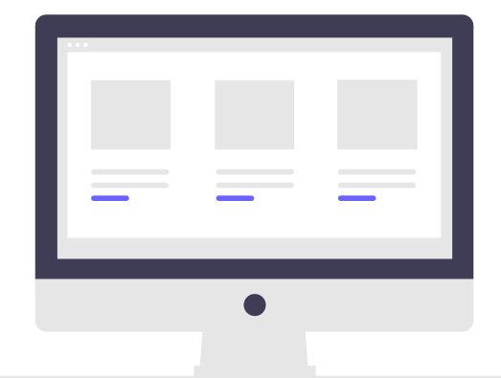
Django
SERVER
DJANGO
WEB
APP
User Browser

Slide 15

Django
SERVER
DJANGO
WEB
APP
User Browser

Slide 16

Django
SERVER
GIT
REPO
DJANGO
WEB
APP
COPY OF
WEBSITE
CODE
User Browser

Slide 17
Django
SSH Connection
Our Computer
SERVER
GIT
REPO
DJANGO
WEB
APP
Git
Commands
COPY OF
WEBSITE
CODE
User Browser

Slide 18
Django
We’ll start off by setting up our Django Web Application using Linode’s marketplace.
This will do a lot of setup work for us automatically, by starting a new Django project and linking it to an IP address on the web at a port.

Slide 19
Django
After that we’ll setup a connection to our own code repository base so we can push/pull updates.

Slide 20
Linode Setup

Slide 21
Django
Pierian Data Link for $100 Linode Credit:
www.linode.com/lp/try/?ifso=pierian

Slide 22
SSH Connection

Slide 23
Django
SSH (Secure SHell) allows us to securely connect to the Linode server that is hosting our Django project.
We don’t want just anybody to be able to visit this computer without permission, so we do it through SSH which requires the password you setup during the Linode Setup process in the previous lecture.

Slide 24
Django
SSH can be intimidating for first time users, but it’s actually a simple way of connecting to a computer through the internet securely.
Just point to the computer (IP Address) and confirm permission through the Password.

Slide 25
Django
Once we connect through SSH, we’ll have access to the Debian Linux shell located at our Linode Server.
This means we’ll be able to use Linux Commands at the Terminal for installations and setups.

Slide 26
Django
Important Note!
Detailed instructions on connecting to Linode through SSH:
www.linode.com/docs/guides/ connect-to-server-over-ssh-on-mac/
www.linode.com/docs/guides/ connect-to-server-over-ssh-on-windows/

Slide 27
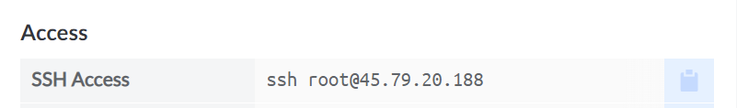
Django
Important Note!
MacOS/Linux Users:
Simply copy/paste SSH command from Linode panel at terminal:

Slide 28
Django
Important Note!
MacOS/Linux Users:
Simply copy/paste SSH command from Linode panel at terminal:

Slide 29
Django
Important Note!
MacOS/Linux Users:
Simply copy/paste SSH command from Linode panel at terminal:

Slide 30
Django
Windows Users:
Windows users can use PowerShell to connect, but we first must install:
OpenSSH Client
Done through “manage optional features” on Windows.

Slide 31
Django
We’ll quickly install OpenSSH Client on a Windows machine, get SSH access, and then all users can follow along at the Debian terminal with the same commands.

Slide 32
Version Control
with git and GitHub

Slide 33
Django
The final step is to be able to store a copy of our code on GitHub (either public or private) and then update our server’s Django project code with any code we’ve updated on GitHub.
Create a free GitHub account before continuing.

Slide 34
Django
Important Note:
This lecture assumes some very basic knowledge of git and GitHub and its overall use for version control.
If you have never used GitHub or git before, do the GitHub tutorial first!
docs.github.com/en/get-started/ quickstart/hello-world

Slide 35
Django
We’ll need to perform the following steps:
SSH Connection to Linode Server
Install git on Linode
Create GitHub Repository
Connect Linode git repo to GitHub
Connect to Github Repo Locally
Push/Pull Changes from Local Computer to Linode Server

